Slide 1

CHEF CONNCET
By: Stephan Pierre, Munif Wahid, Jeremias Batista, Isaac Amos, Karim Khalil, Nelson Acero

Slide 2
Agenda
Member Roles/Job Delegation
Use Cases/Action Illustration
Use Case 1 Demo
Use Case 2 Demo
Revenue Stream Demo
Stored Procedure/Transaction Demo
Explanation of 2NF Diagram
Takeaways from Project
QnA

Slide 3
Member Roles
BACKEND TEAM:
Stephan Pierre
Munif Wahid
Nelson Acero
FRONTEND TEAM: Jeremias B Rivera
Isaac Amos
Karim Khalil

Slide 4
Use Cases
Use case 1:
Use case 2:
01
02
Login / Sign up
Fill in Pantry Profile
Browse Chefs
Select Date & Time
Book Chef
User to chef
Leave Review
Chef Cooks Meal
Edit/ Confirm Pantry

Slide 5
Use case demo 1
Login / Sign up
Fill in Pantry Profile
Browse Chefs
Select Date & Time
Book Chef
Leave Review
Chef Cooks Meal
Edit/ Confirm Pantry

Slide 6
Use Case demo 2

Slide 7
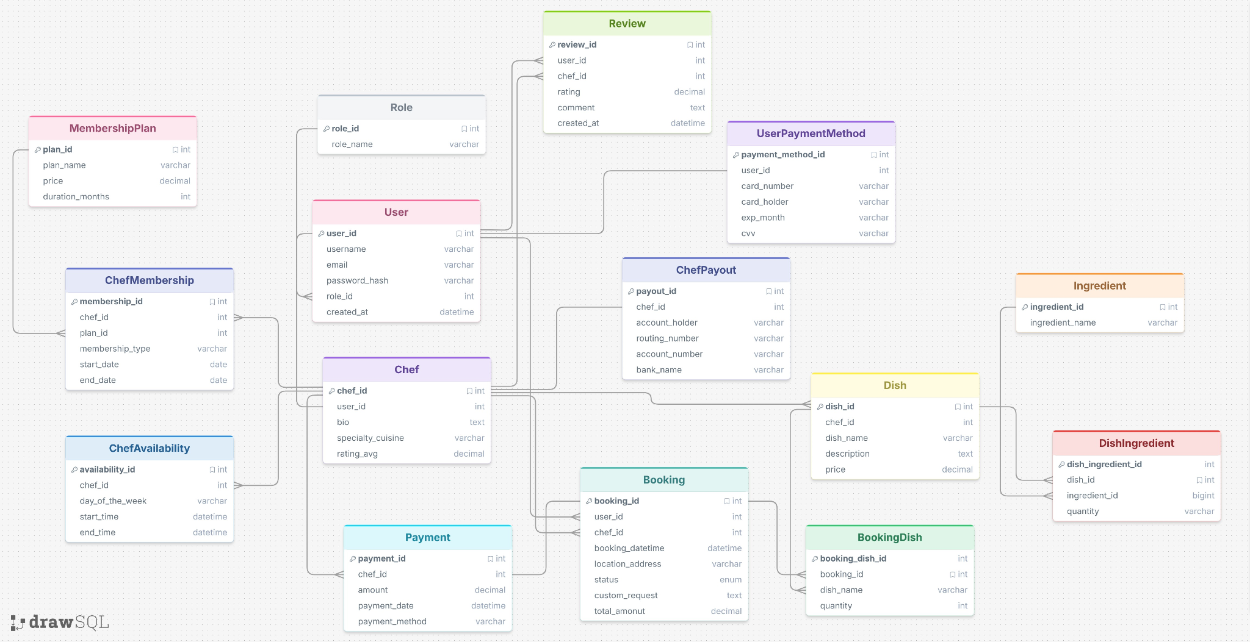
2NF Diagram

Slide 8
Revenue Stream 3

Slide 9
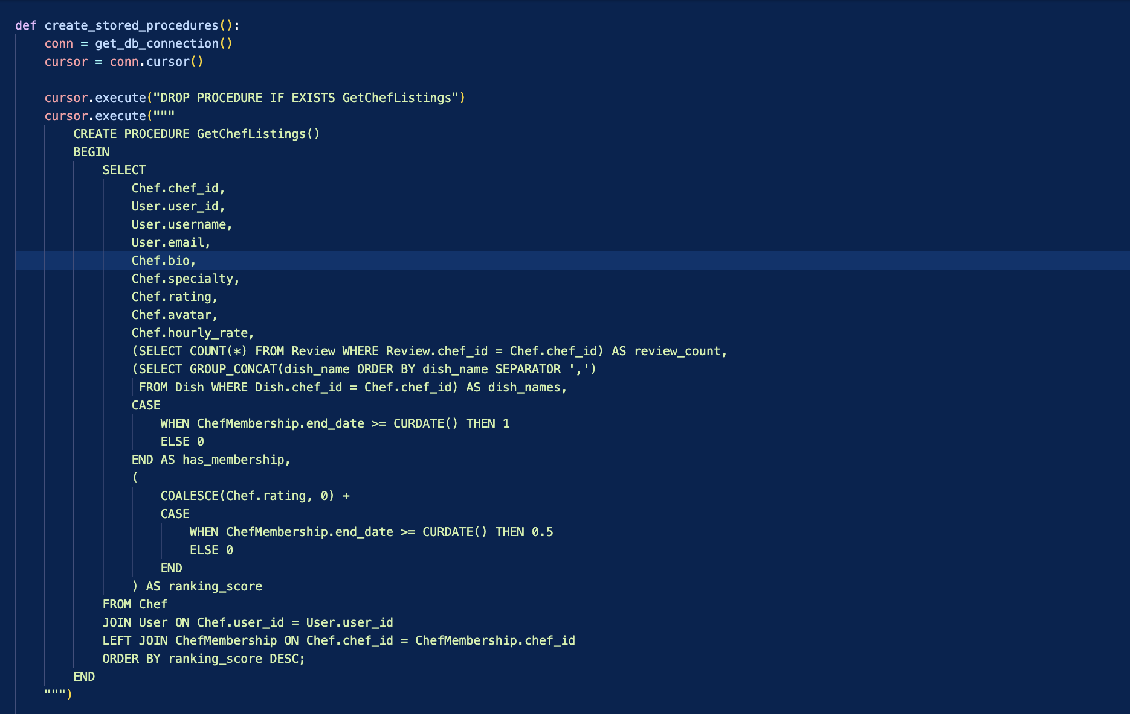
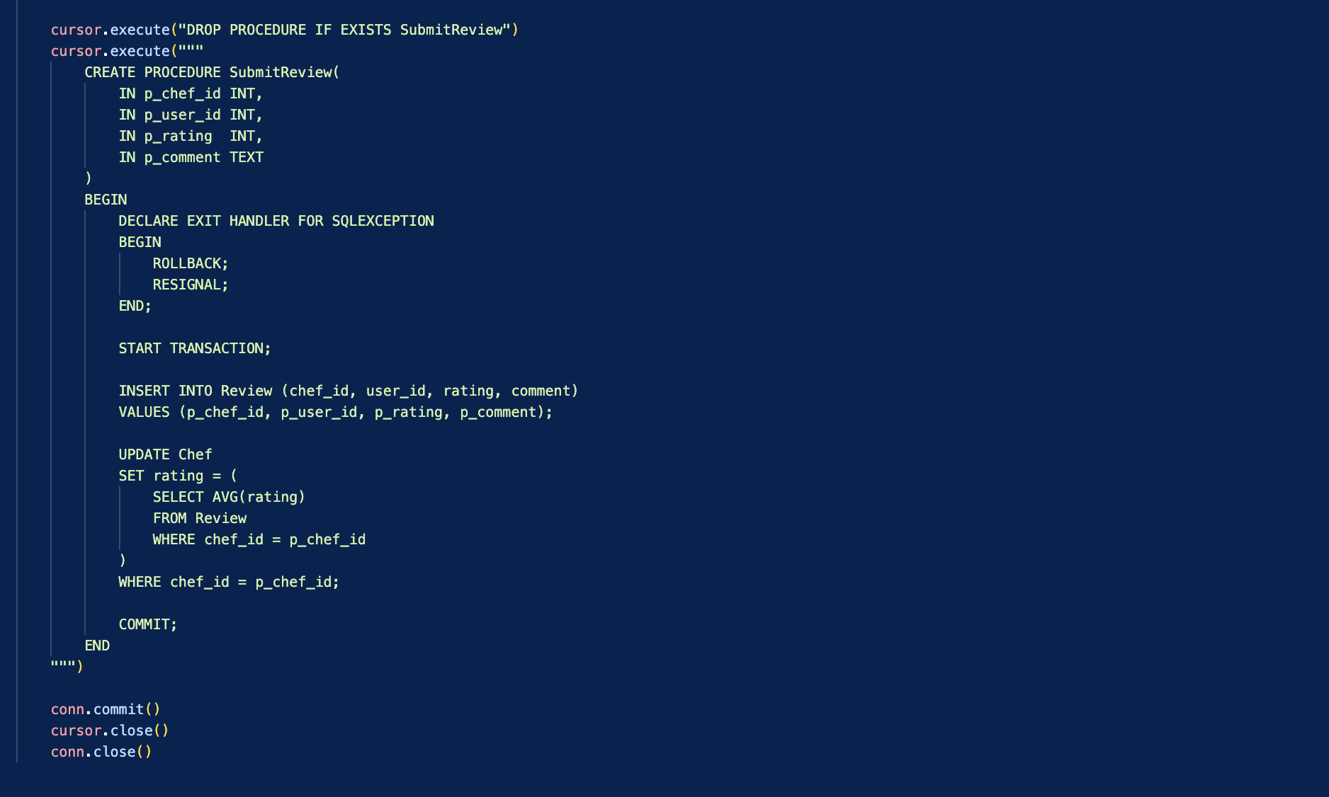
Stored Procedures Demo

Slide 10

Takeaways
Describe a new technology you used this semester and explain why you found it especially useful or not useful at all
One technology we hadn't used before was Docker. Docker let us package the entire MySQL environment into a container, so anyone cloning the repo could run one command and have the exact same database running instantly. It removed the 'works on my machine' problem entirely."

Slide 11
Conclusions
Any questions?

